Slide 1

Azure App Configuration
Haitham Shaddad
Tech Lead @WooliesX
@Haitham_shaddad

Slide 2
History of app settings in asp.net
web.config
appsettings.json
Azure App Service Configuration

Slide 3
Problems !
No history
Not centralized
Does not refresh
Tightly coupled to code/tech

Slide 4
App Configuration Features
A fully managed service.
Versioning with labels.
Point-in-time replay of settings.
Manage feature flags
Enhanced security through Azure-managed identities.
Complete data encryption, at rest or in transit.
Native integration with popular frameworks, including .NET and Java.

Slide 5

Demo
Notes:
ManagedIdentityCredential
Package: Azure.Identity

Slide 6
Feature Flags

Slide 7
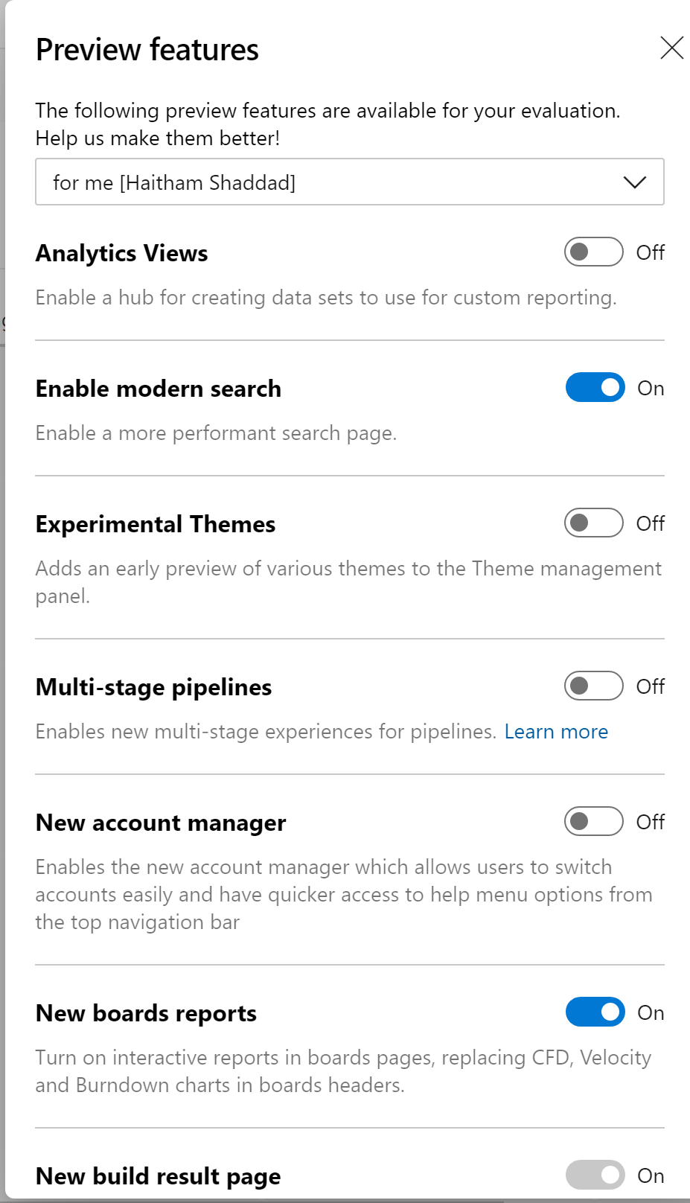
Feature Flags
Notes:
Turn on/off features in application
Deploy without letting users know about the feature
Target specific audience for the feature
Easier than having if/else with too many configurations

Slide 8
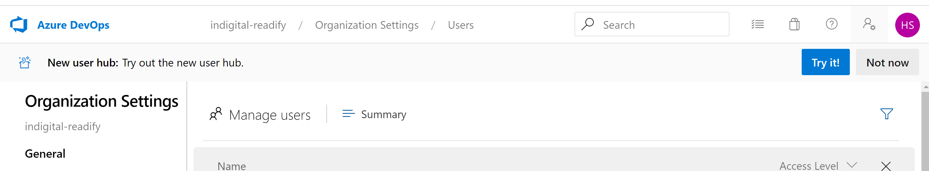


Slide 9

Why feature flags?
Ship half-finished features
Experimentation
Test in production & Kill a feature
Incremental release
Trunk-based development
Throttling

Slide 10

Lets write some code

Slide 11

Built-In Feature Filters
Microsoft.Percentage (Value)
Microsoft.TimeWindow (Start & End)
Notes:
"EnhancedPipeline": { "EnabledFor": [ { "Name": "Microsoft.Percentage", "Parameters": { "Value": 50 } } ] }
"Back2Base": {
"EnabledFor": [
{
"Name": "Microsoft.TimeWindow",
"Parameters": {
"Start": "11 November 2019 02:00:00 +00:00",
"End": "29 Dec 2019 01:00:00 +00:00"
}
}
]
}

Slide 12
Pricing
 | FREE | STANDARD
Resources per subscription | 1 | Unlimited
Storage per resource | 10 MB | 1 GB
Key history | 7 days | 30 days
Requests per day | 1,000 (HTTP status code 429 will be returned for all requests once the limit is reached) | First 200,000 included in the daily charge. Additional requests will be billed as overage.
SLA | None | 99.9% availability
Security functionality | Encryption with Microsoft-managed keys HMAC or AAD authentication RBAC support Managed identity | All Free tier functionality plus: Encryption with customer-managed keys Private Link support
Cost | Free | $1.20 per day, plus an overage charge at $0.06 per 10,000 requests

Slide 13

Questions?

Slide 14

Thank you

